Slide 1



IEA EBC Annex 83 on Positive Energy Districts
Second International Energy Agency, Energy in Buildings and Communities, Annex 83 Ph.D. Summer School
“Principles of energy system modelling for Positive Energy Districts”
Catania, Italy
June 12 – 16, 2023
Rosaria Volpe

Slide 2
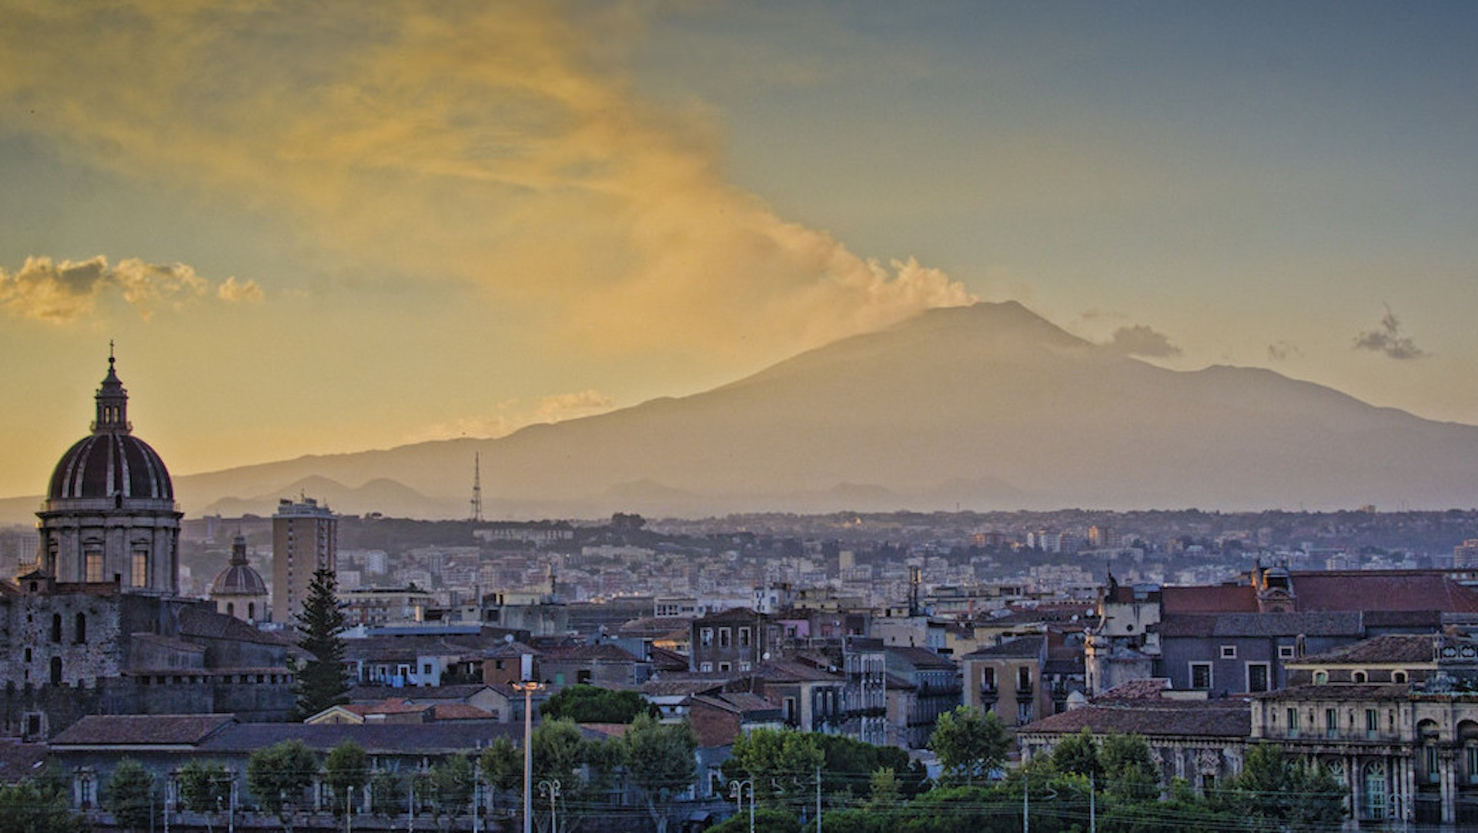
Second IEA EBC Annex 83 Ph.D. Summer School
IEA EBC Annex 83 on Positive Energy Districts
General Chairs
Rosaria Volpe, University of Catania, Italy
Francesco Guarino, University of Palermo, Italy
Organizing Committee
Rosaria Volpe, University of Catania, Italy
Francesco Guarino, University of Palermo, Italy
Maurizio Cellura, University of Palermo, Italy
Alberto Fichera, University of Catania, Italy
Francesco Reda, VTT Technical Research Center, Finland
Ala Hasan, VTT Technical Research Center, Finland
Hassam Rehman, VTT Technical Research Center, Finland
Adriano Bisello, EURAC Research, Italy
Topi Rasku, VTT Technical Research Center, Finland

Slide 3
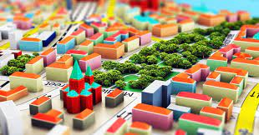
Schedule: Monday
IEA EBC Annex 83 on Positive Energy Districts
09:00 – 11:00 | School program introduction and students' presentation
11:00 – 11:30 | Break
11:30 – 13:30 | Lecture, Dr. Adriano Bisello Urban planning, governance perspective, and multiple benefits evaluation in PED
13:30 – 14:30 | Lunch
14:30 – 16:30 | Group activity, Dr. Adriano Bisello Integrated sustainability assessment of PEDs. Expected multiple benefits

Slide 4
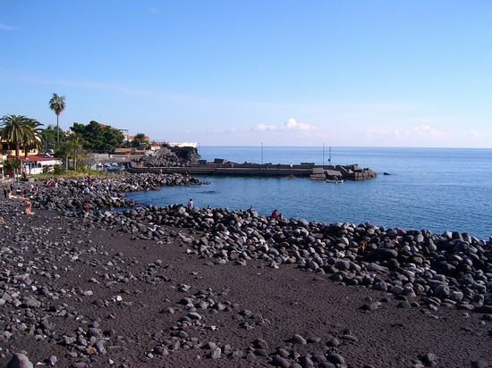

Schedule: Tuesday
IEA EBC Annex 83 on Positive Energy Districts
09:00 – 11:00 | Lecture, Prof. Giuseppe Inturri Mobility in Positive Energy Districts
11:30 – 18:30 | Social activity: Black Sand Beach

Slide 5
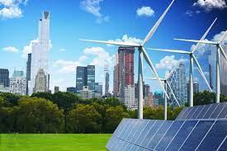

Schedule: Wednesday
IEA EBC Annex 83 on Positive Energy Districts
09:00 – 11:00 | Lecture, Dr. Abolfazl Rezaei Renewable-based energy systems in districts
11:00 – 11:30 | Break
11:30 – 13:30 | Group activity, Dr. Abolfazl Rezaei Simulation of load curves and components
13:30 – 14:30 | Lunch
14:30 – 16:30 | Lecture, Prof. Rosaria Volpe Energy audits and monitoring for Positive Energy Districts
16:30 – 16:45 | Break
16:45 – 18:45 | Group activity, Prof. Rosaria Volpe Control and CUSUM charts for PEDs

Slide 6


Schedule: Thursday
IEA EBC Annex 83 on Positive Energy Districts
09:00 – 11:00 | Lecture, Prof. Maurizio Cellura and Prof. Francesco Guarino Positive Energy Districts case-studies: towards an urban carbon footprint
11:00 – 11:30 | Break
11:30 – 13:30 | Group activity, Prof. Maurizio Cellura and Prof. Francesco Guarino Energy and carbon balance calculations
13:30 – 14:30 | Lunch
14:30 – 16:30 | Lecture, Dr. Topi Rasku Modelling the energy market impacts of PEDs
16:30 – 16:45 | Break
16:45 – 18:45 | Group activity, Dr. Topi Rasku SpineOpt demo

Slide 7

Schedule: Friday
IEA EBC Annex 83 on Positive Energy Districts
09:00 – 11:00 | Round-table
11:00 – 11:30 | Break
11:30 – 13:30 | Results’ presentation and greetings

Slide 8
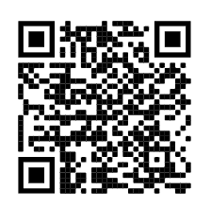
Some info before we start…
IEA EBC Annex 83 on Positive Energy Districts
If not yet done, please download the tools/programs that will be used during the upcoming Lectures!
Use the following link or the QR code to look into the Lectures and pics! Upload all your material and pictures in these folder and SHARE! Use the hashtag #annex83catania
https://drive.google.com/drive/folders/1bvZn3n0Zs-ug4tFmmVjsGhkqEDkejKc4
Wifi: plaza

Slide 9

Thank you!!!
IEA EBC Annex 83 on Positive Energy Districts
LET’S START…

